Slide 1
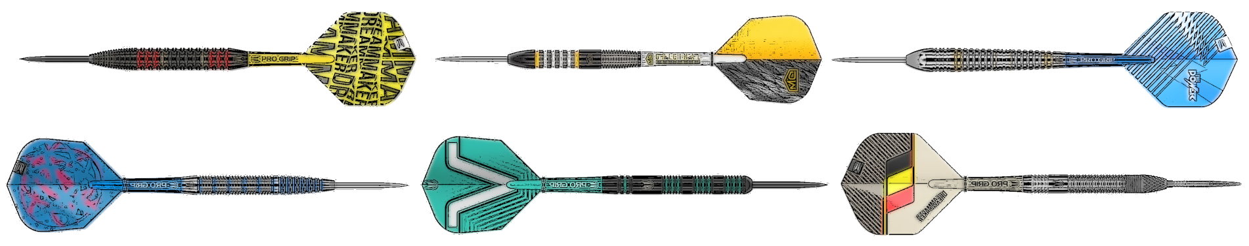
Automated Darts Scoring and Intelligent Shot Recommendation System
Alfred Carpenter

Slide 2
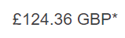
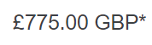
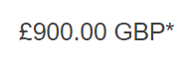
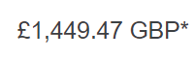
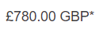
Existing Systems
Scolia
AutoDarts
Research Papers

Slide 3
Objectives
Create a system that can use automatic dart detection as a method for applying the theoretical studies of strategy optimisation.

Slide 4
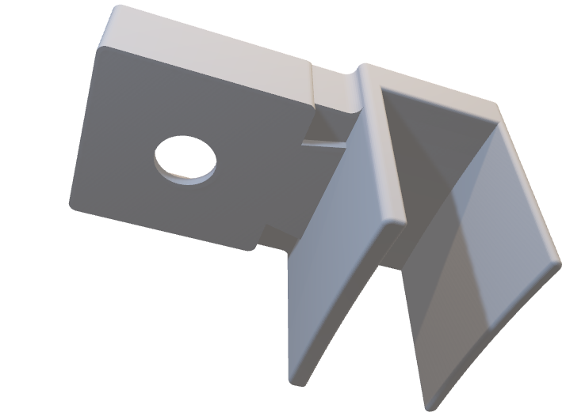
Approach
Python
Flask
3 Cameras
3D printed parts

Slide 5
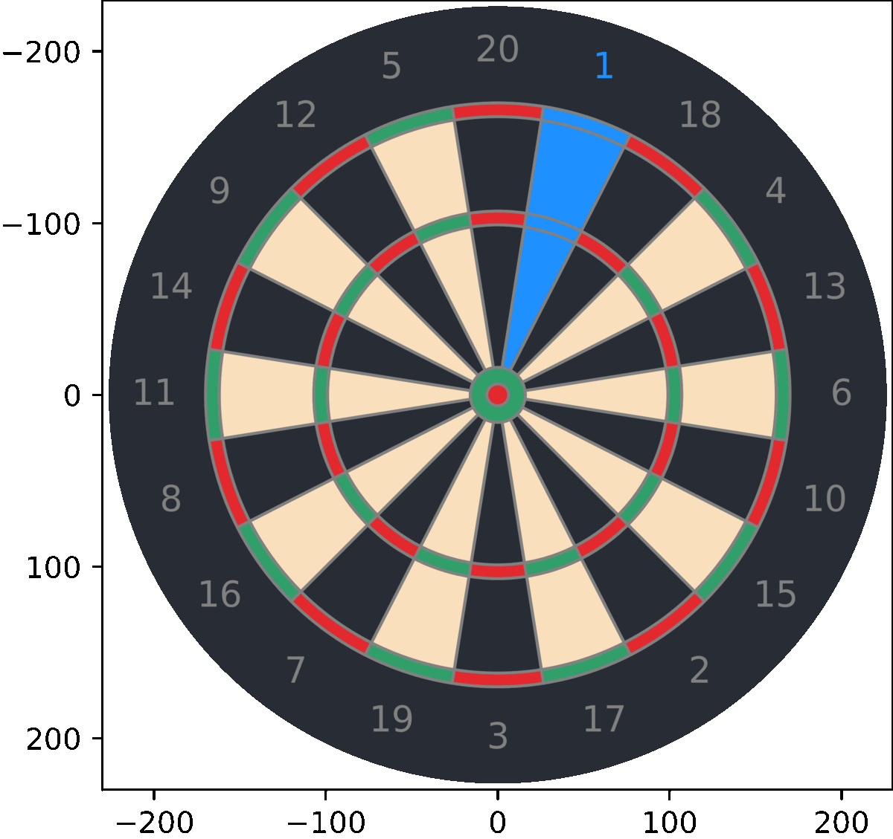
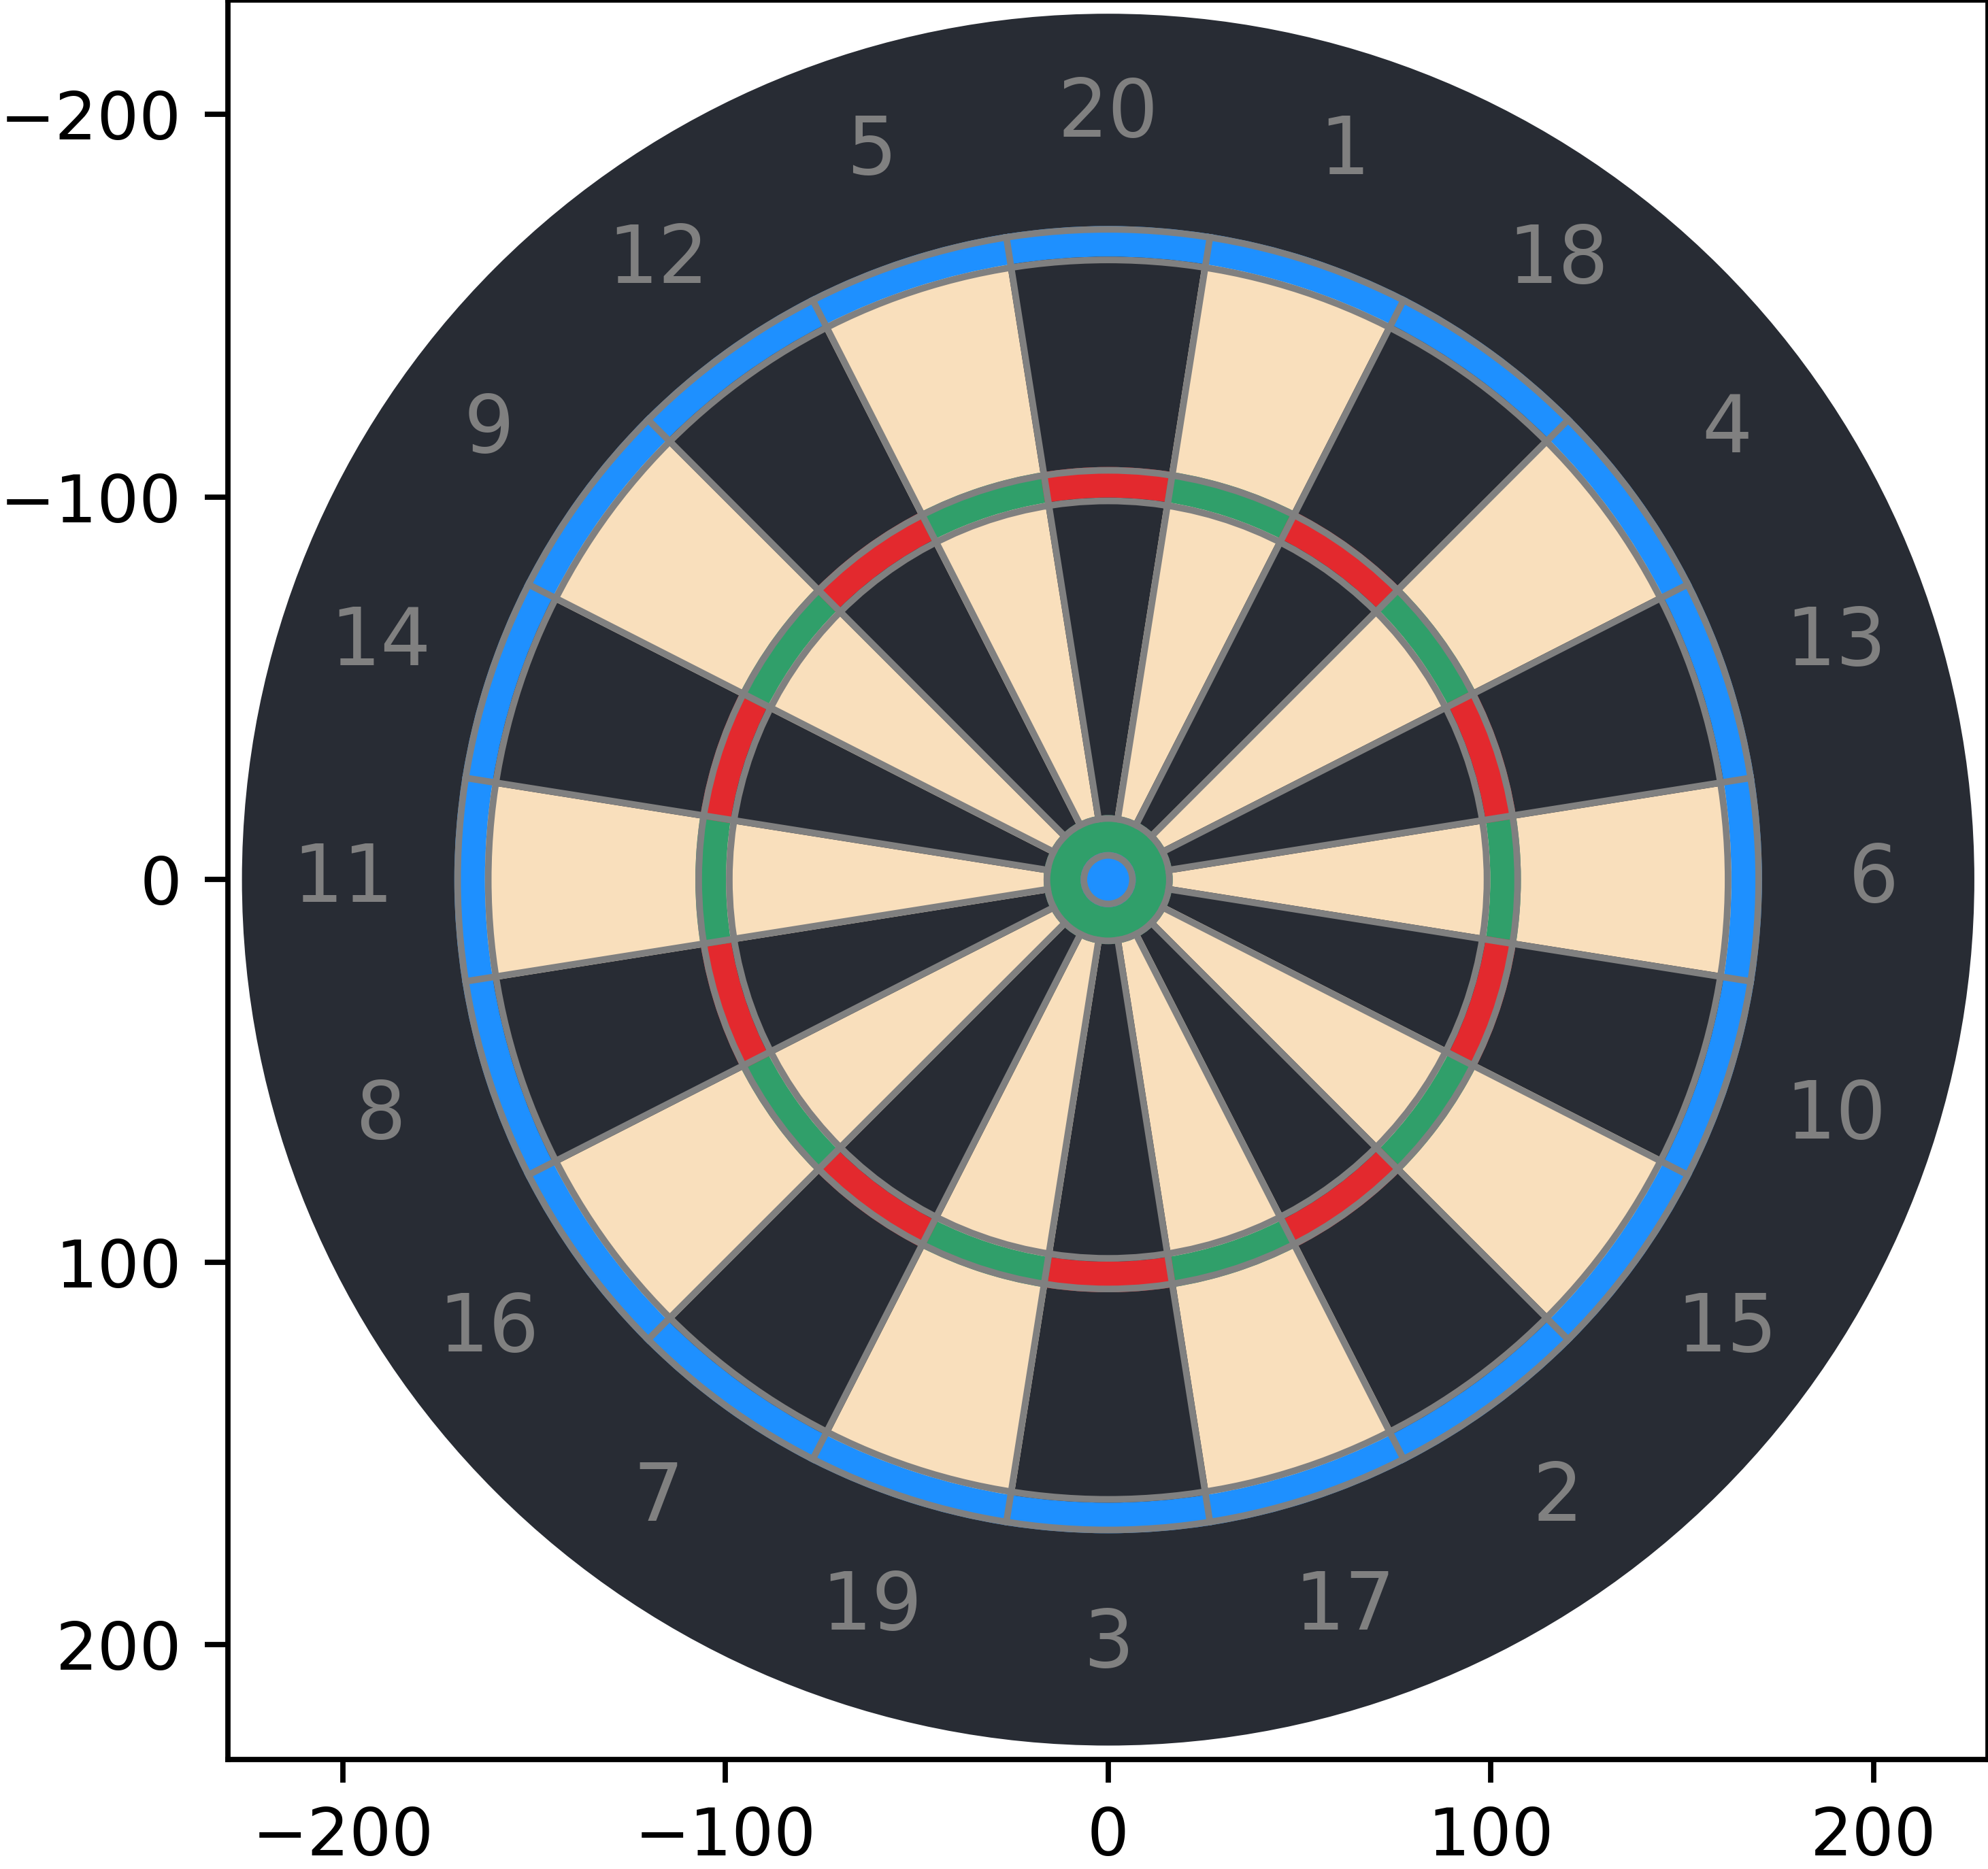
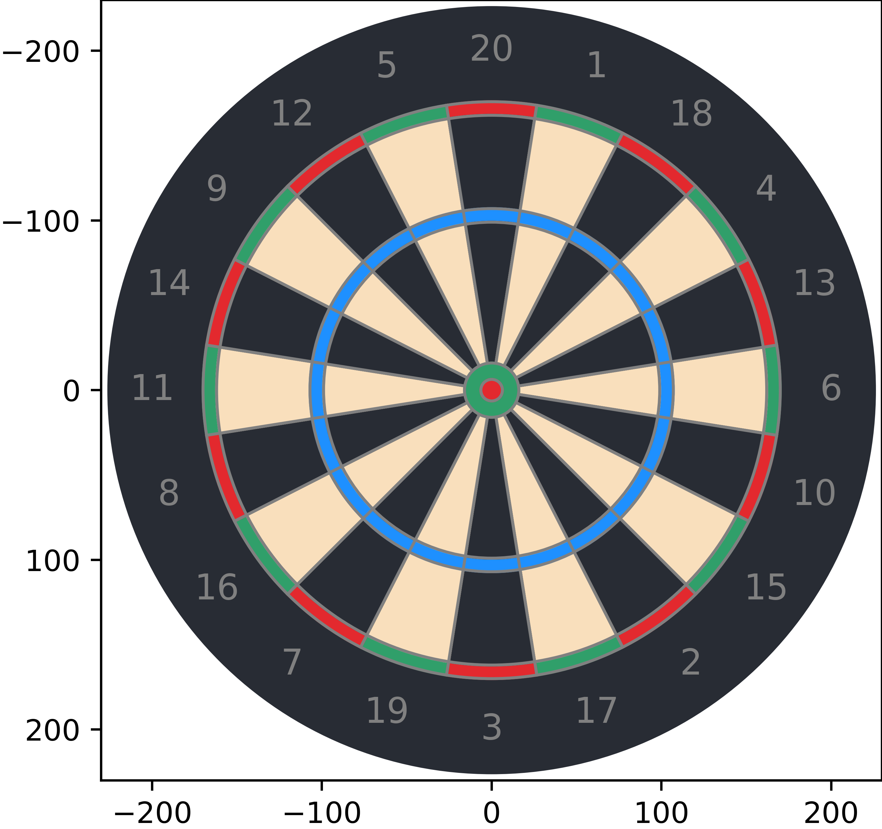
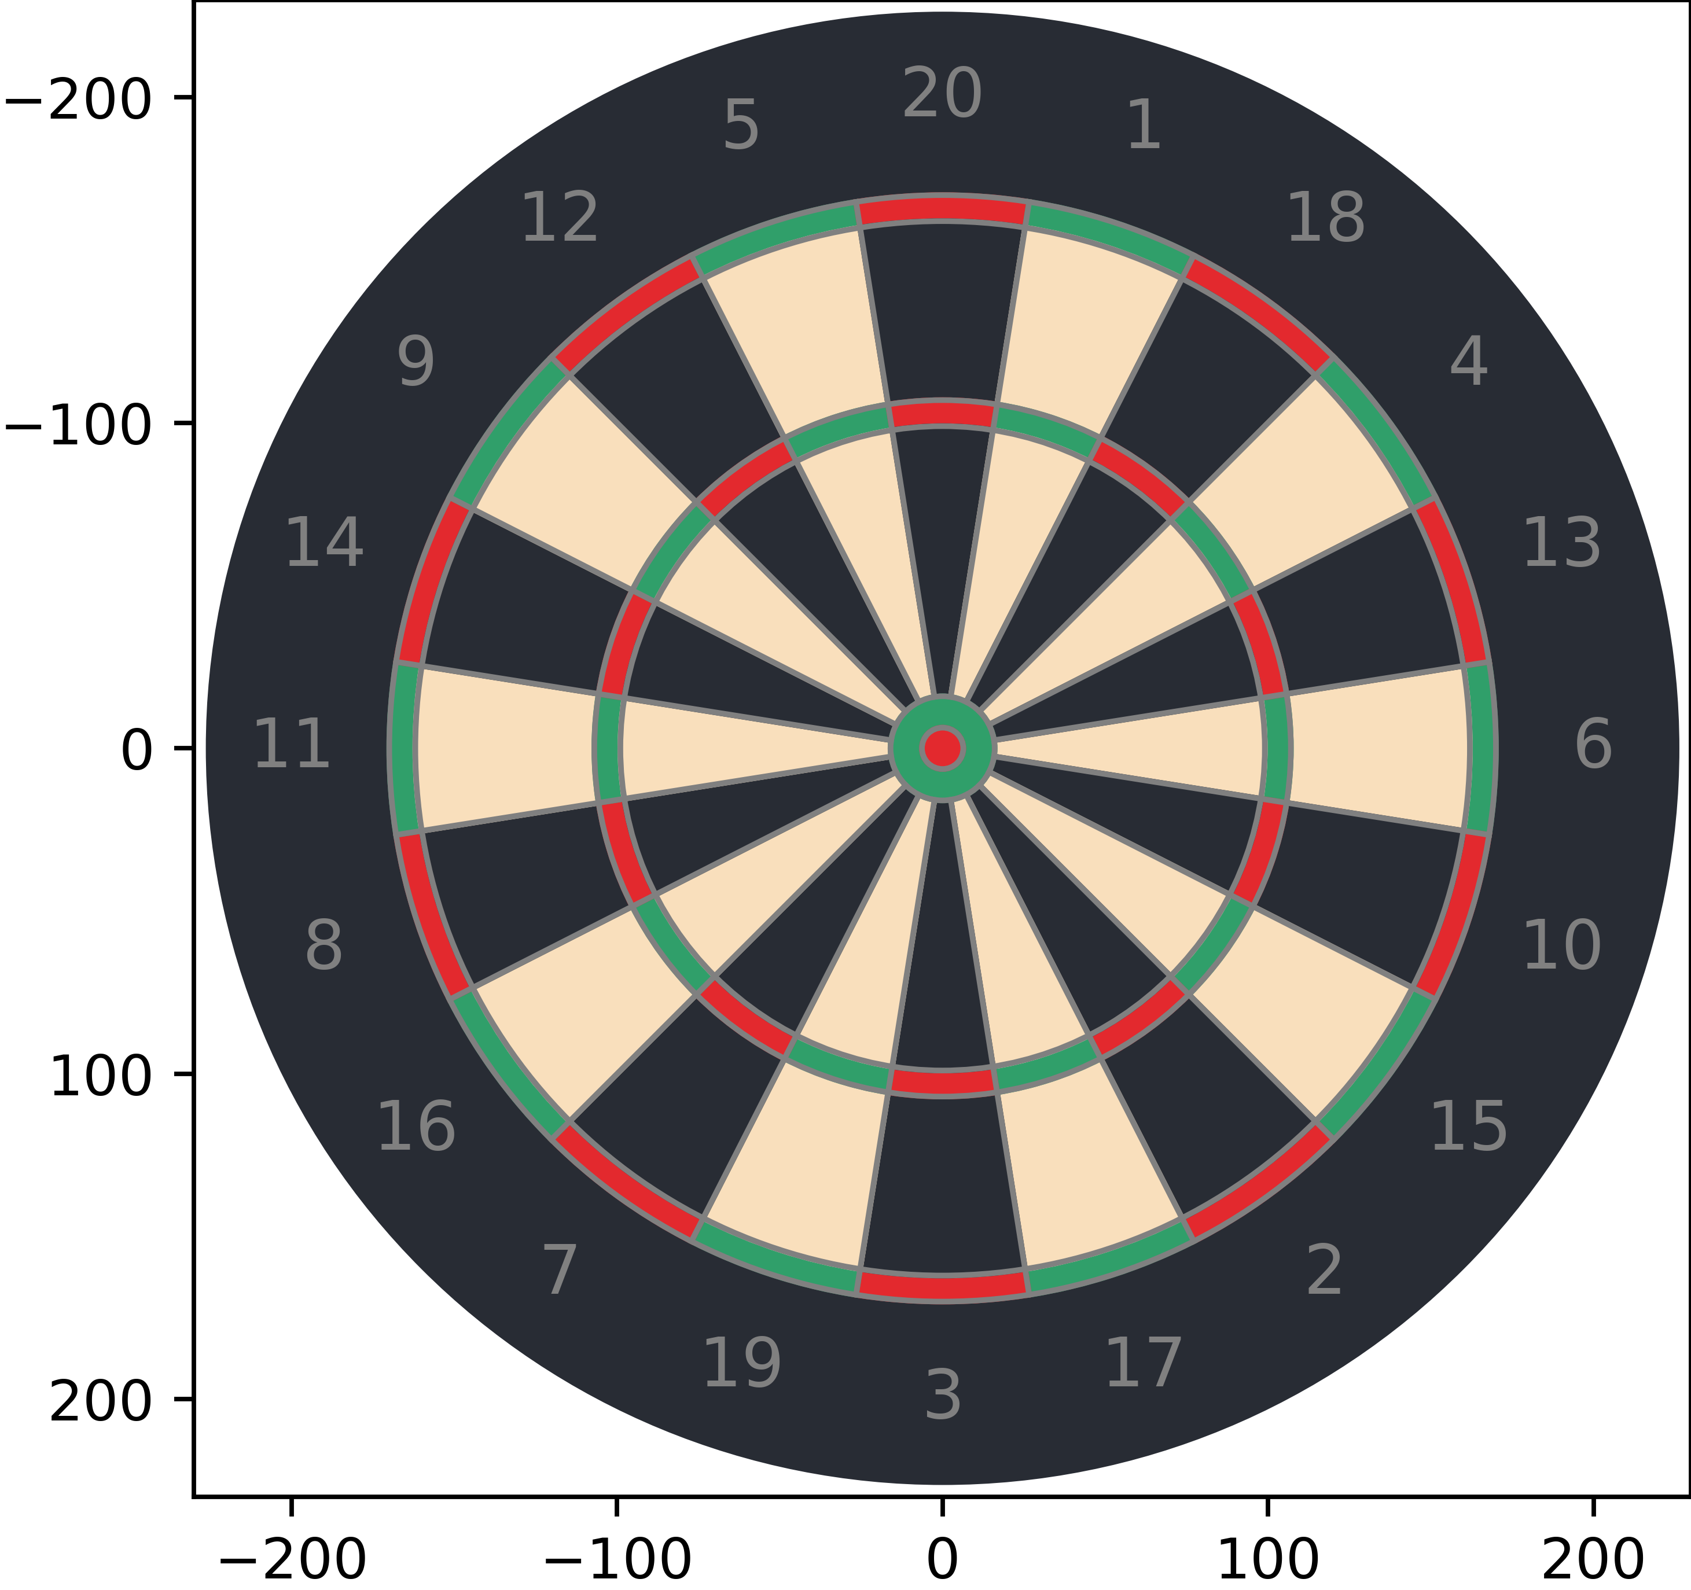
The Dartboard
20 Segments:
The board is divided into sections numbered from 1 to 20, each representing a different score.
Doubles Ring:
The narrow ring around the outer edge of the dartboard doubles the score of the segment it is contained in.
Triples Ring:
The even narrower ring located inside the doubles ring triples the score of the segment it is contained in.
Inner Bullseye:
The smallest central circle on the dartboard, worth 50 points.
Outer Bullseye:
The larger circle surrounding the inner bullseye, worth 25 points.
Double regions
Tripple regions

Slide 6
The Game of Darts
We are considering games following the x01 format:
The game begins with a predetermined number of points, i.e., 301, 501, 701, 901, and 1101.
Objective:
Players aim to reduce their score to exactly 0.
The first player to achieve this goal wins the game.
Gameplay:
Each player takes turns throwing three darts per round.
Scoring Rules:
Players must finish with a double to win.
Going below zero results in a "BUST," requiring players to restart from their previous round's score.

Slide 7
Project Management
1 | Dart Detection
 | Dart Detection
 | Multi Dart Detection
 | End of Visit Detection
 | Triangulation
 | Calibration and Positioning
2 | Shot Recommendation
 | Standard Deviation
 | Skewed Deviation
 | Aiming Algorithm to Maximise Score
 | Aiming Algorithm to Maximise Probability of Checkout in 3 darts
 | Shot Recommendation
3 | General Development
 | Scoring
 | Game Play
 | Graphical Scoring Display
 | 2D Board Representation
 | 3D Board Representation

Slide 8
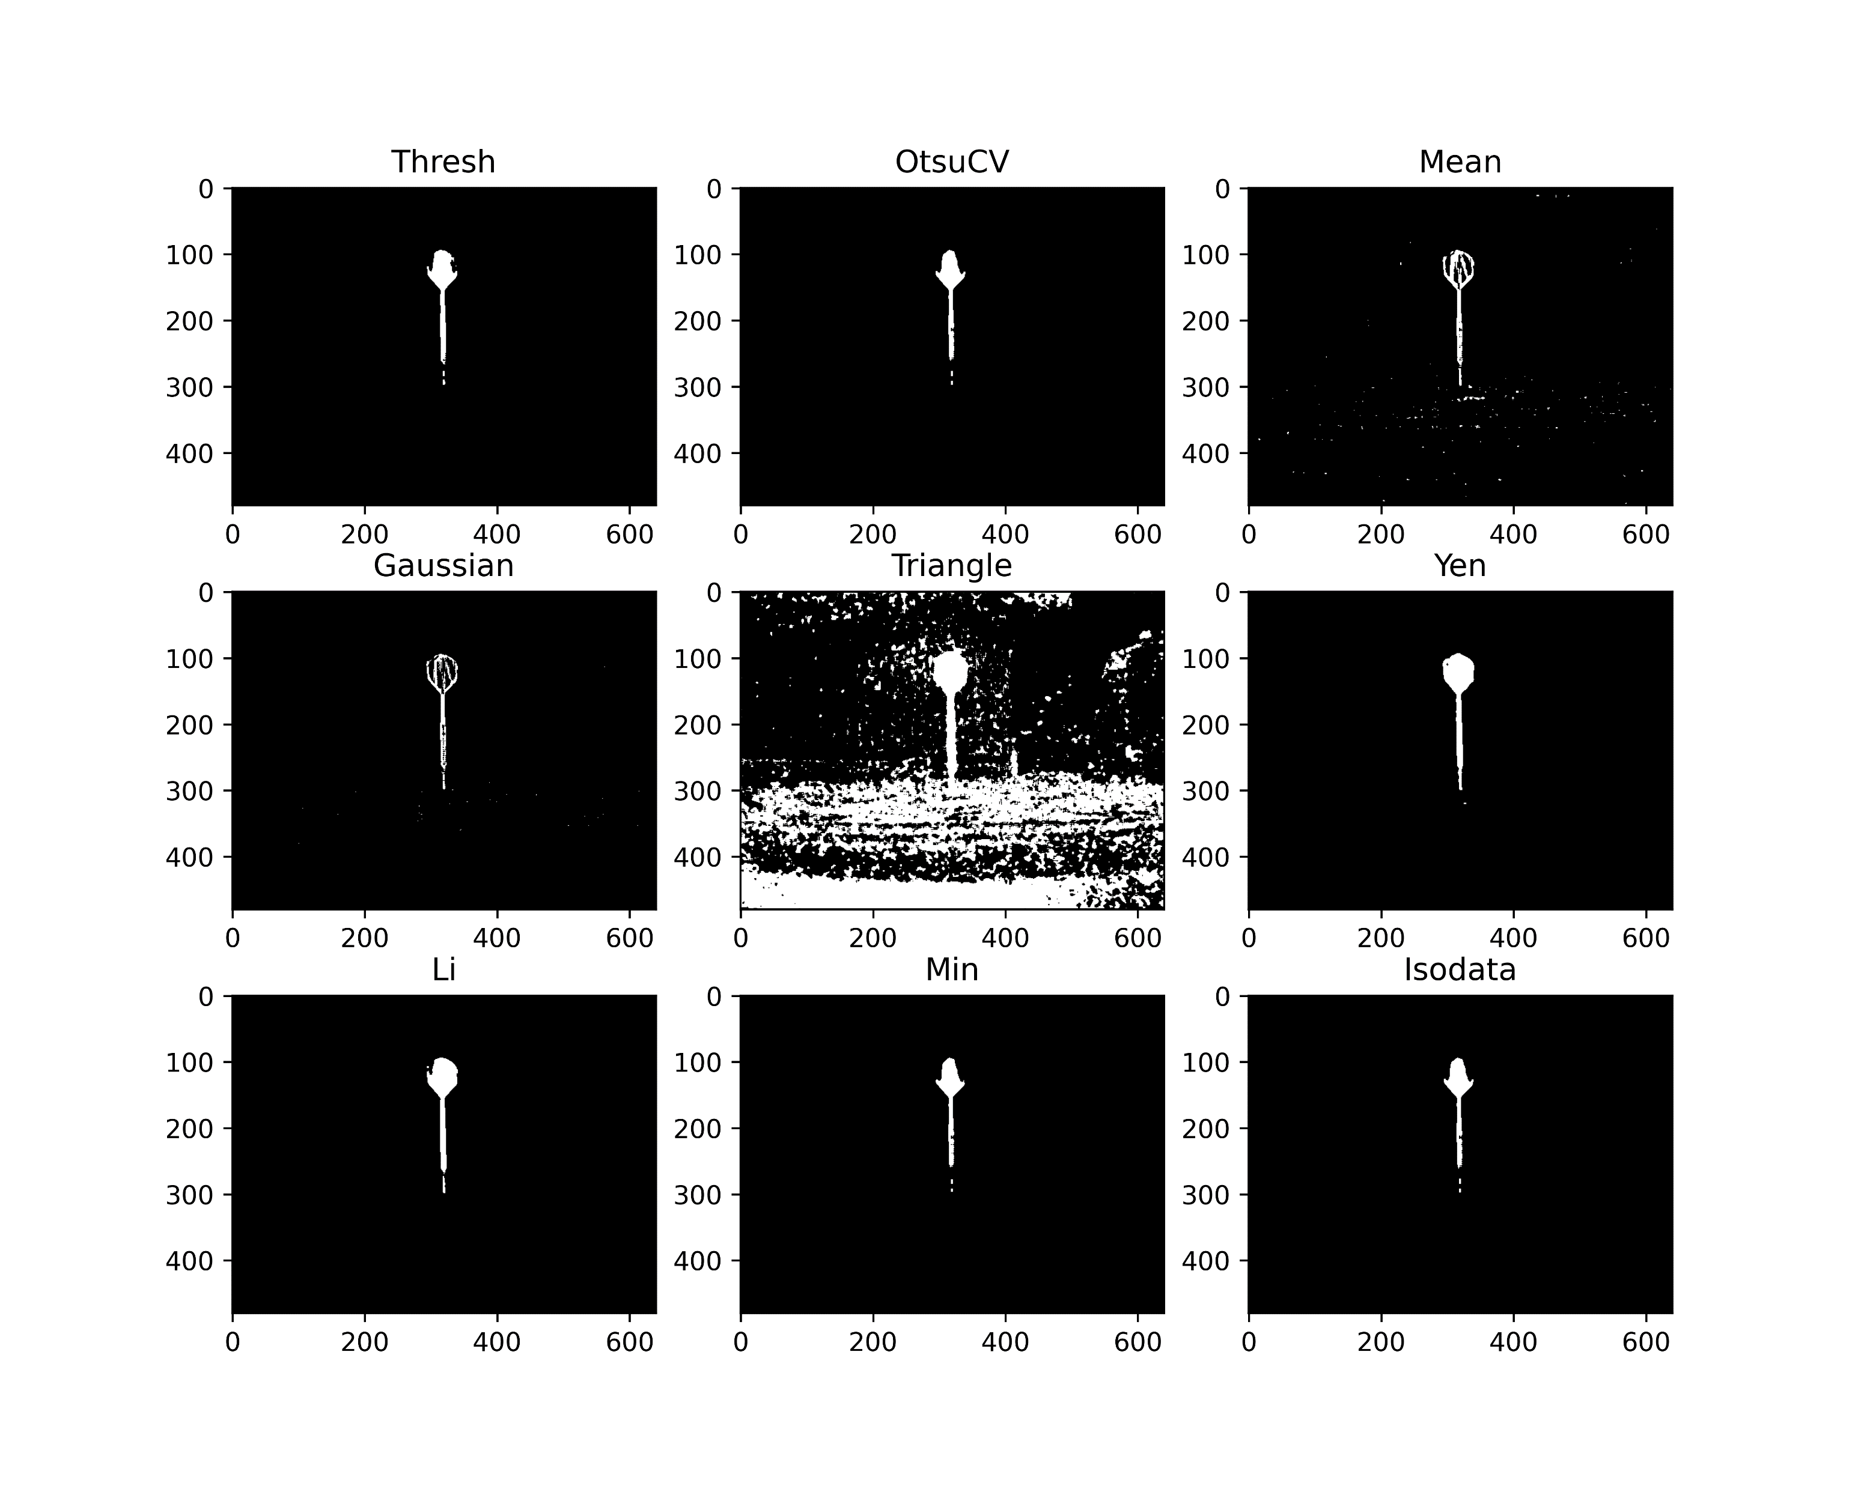
Dart Detection
Thresholding operations

Slide 9
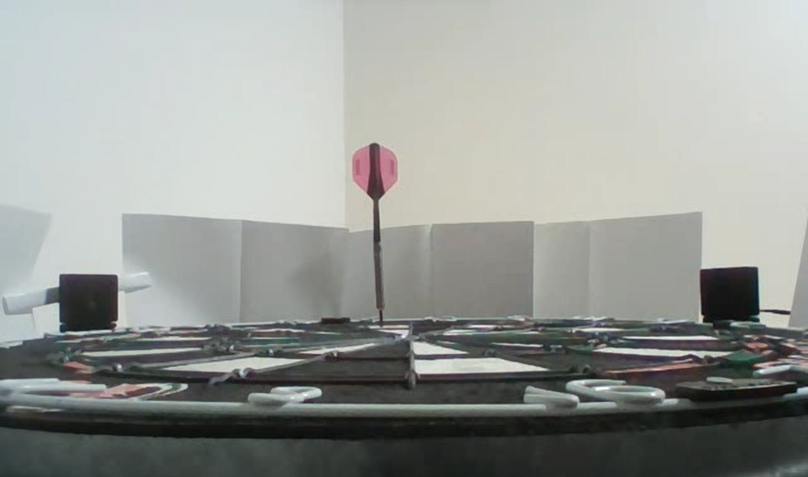
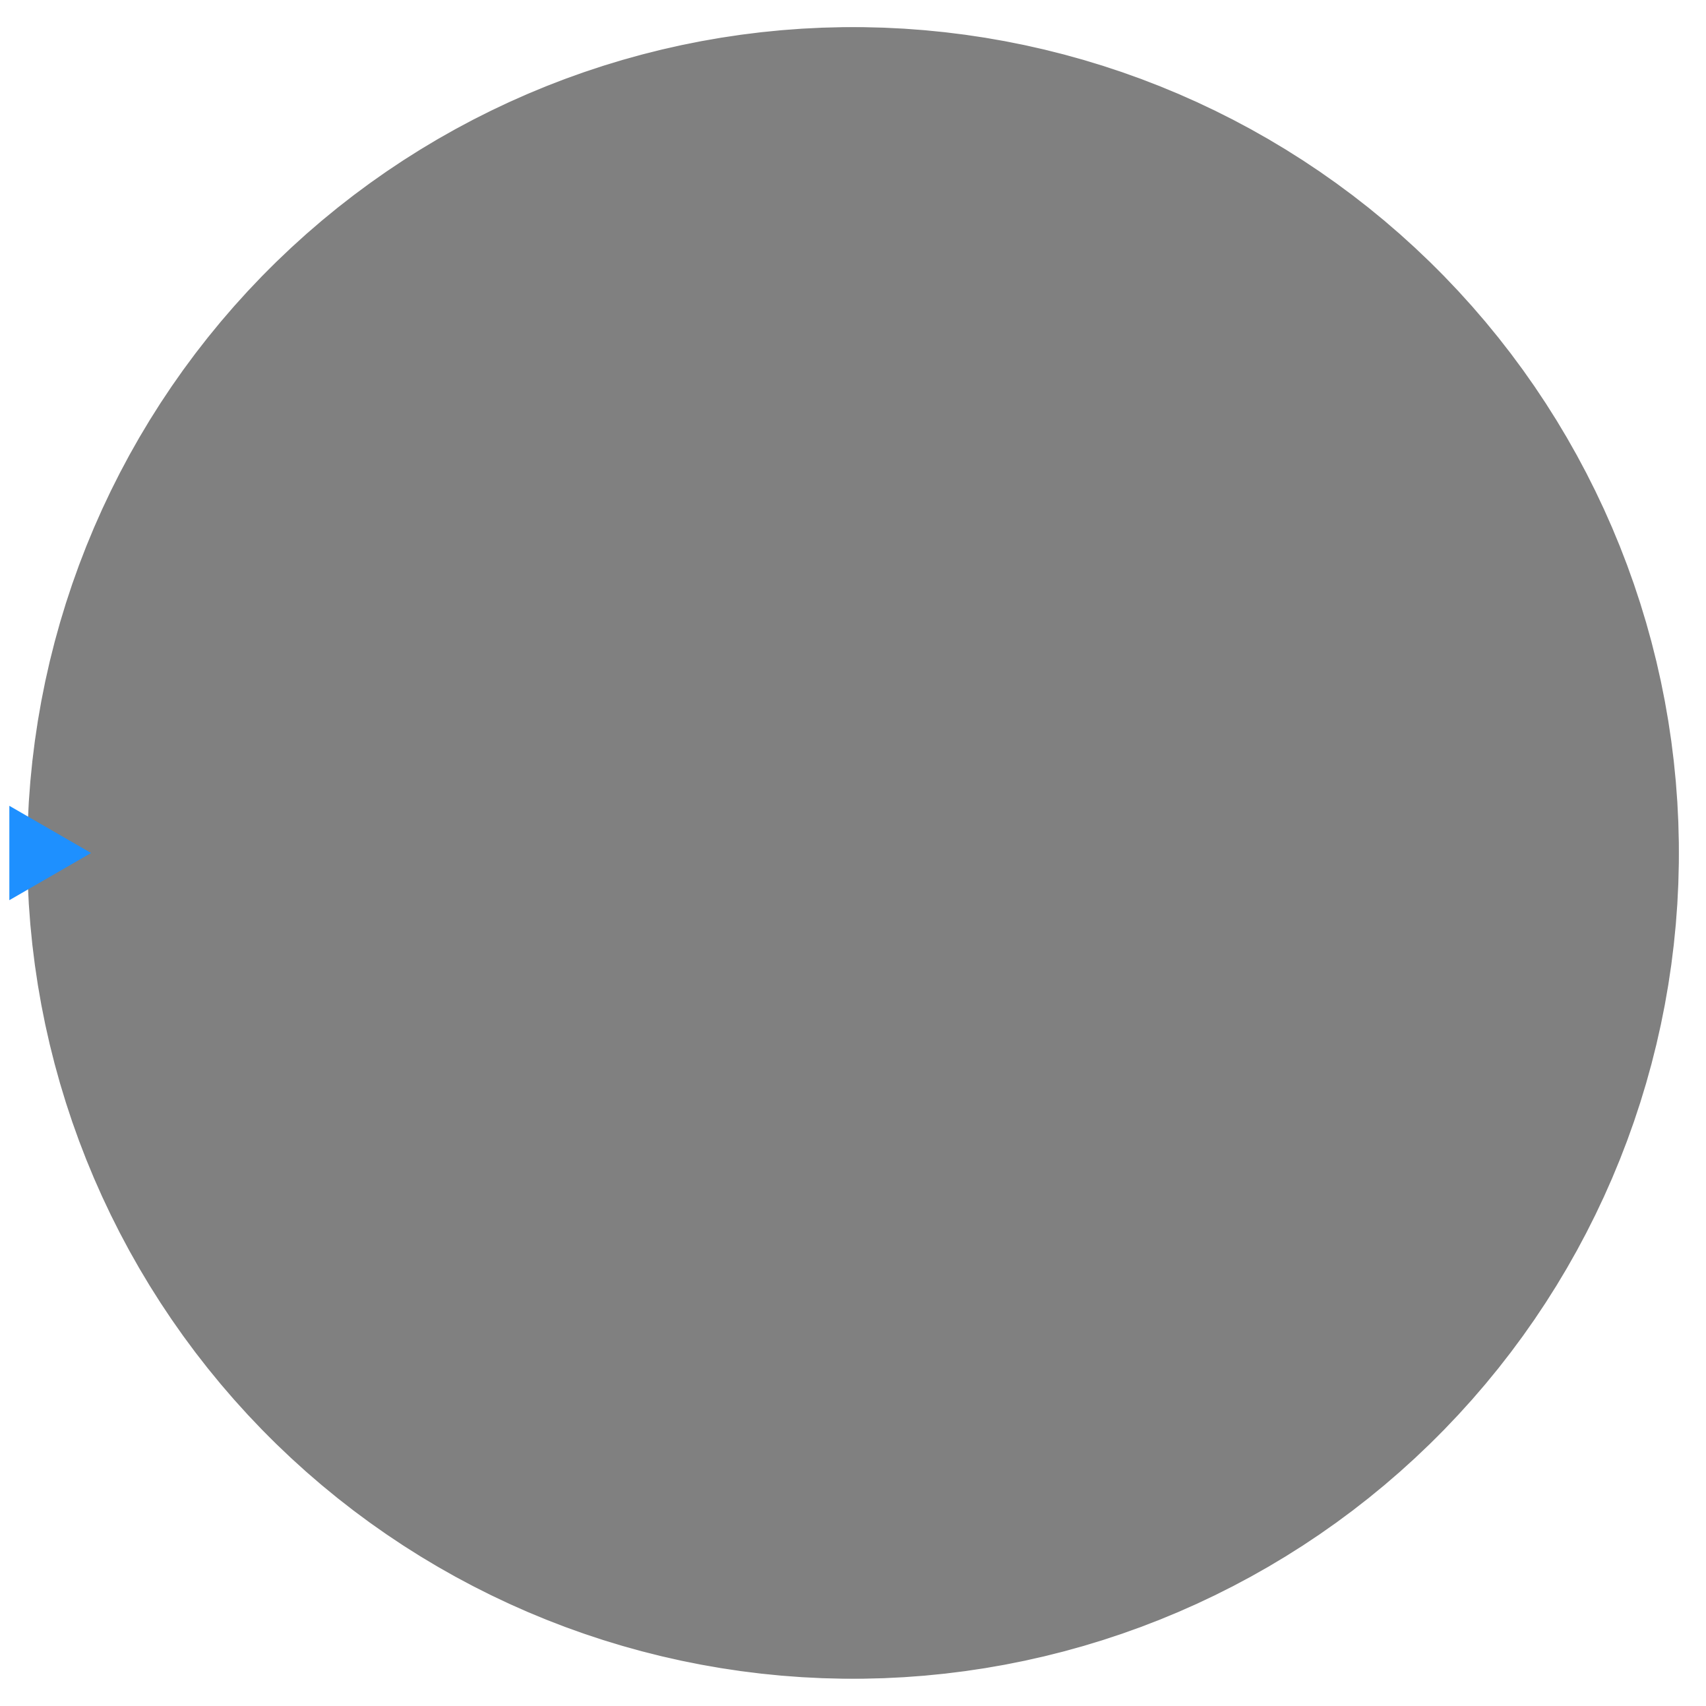
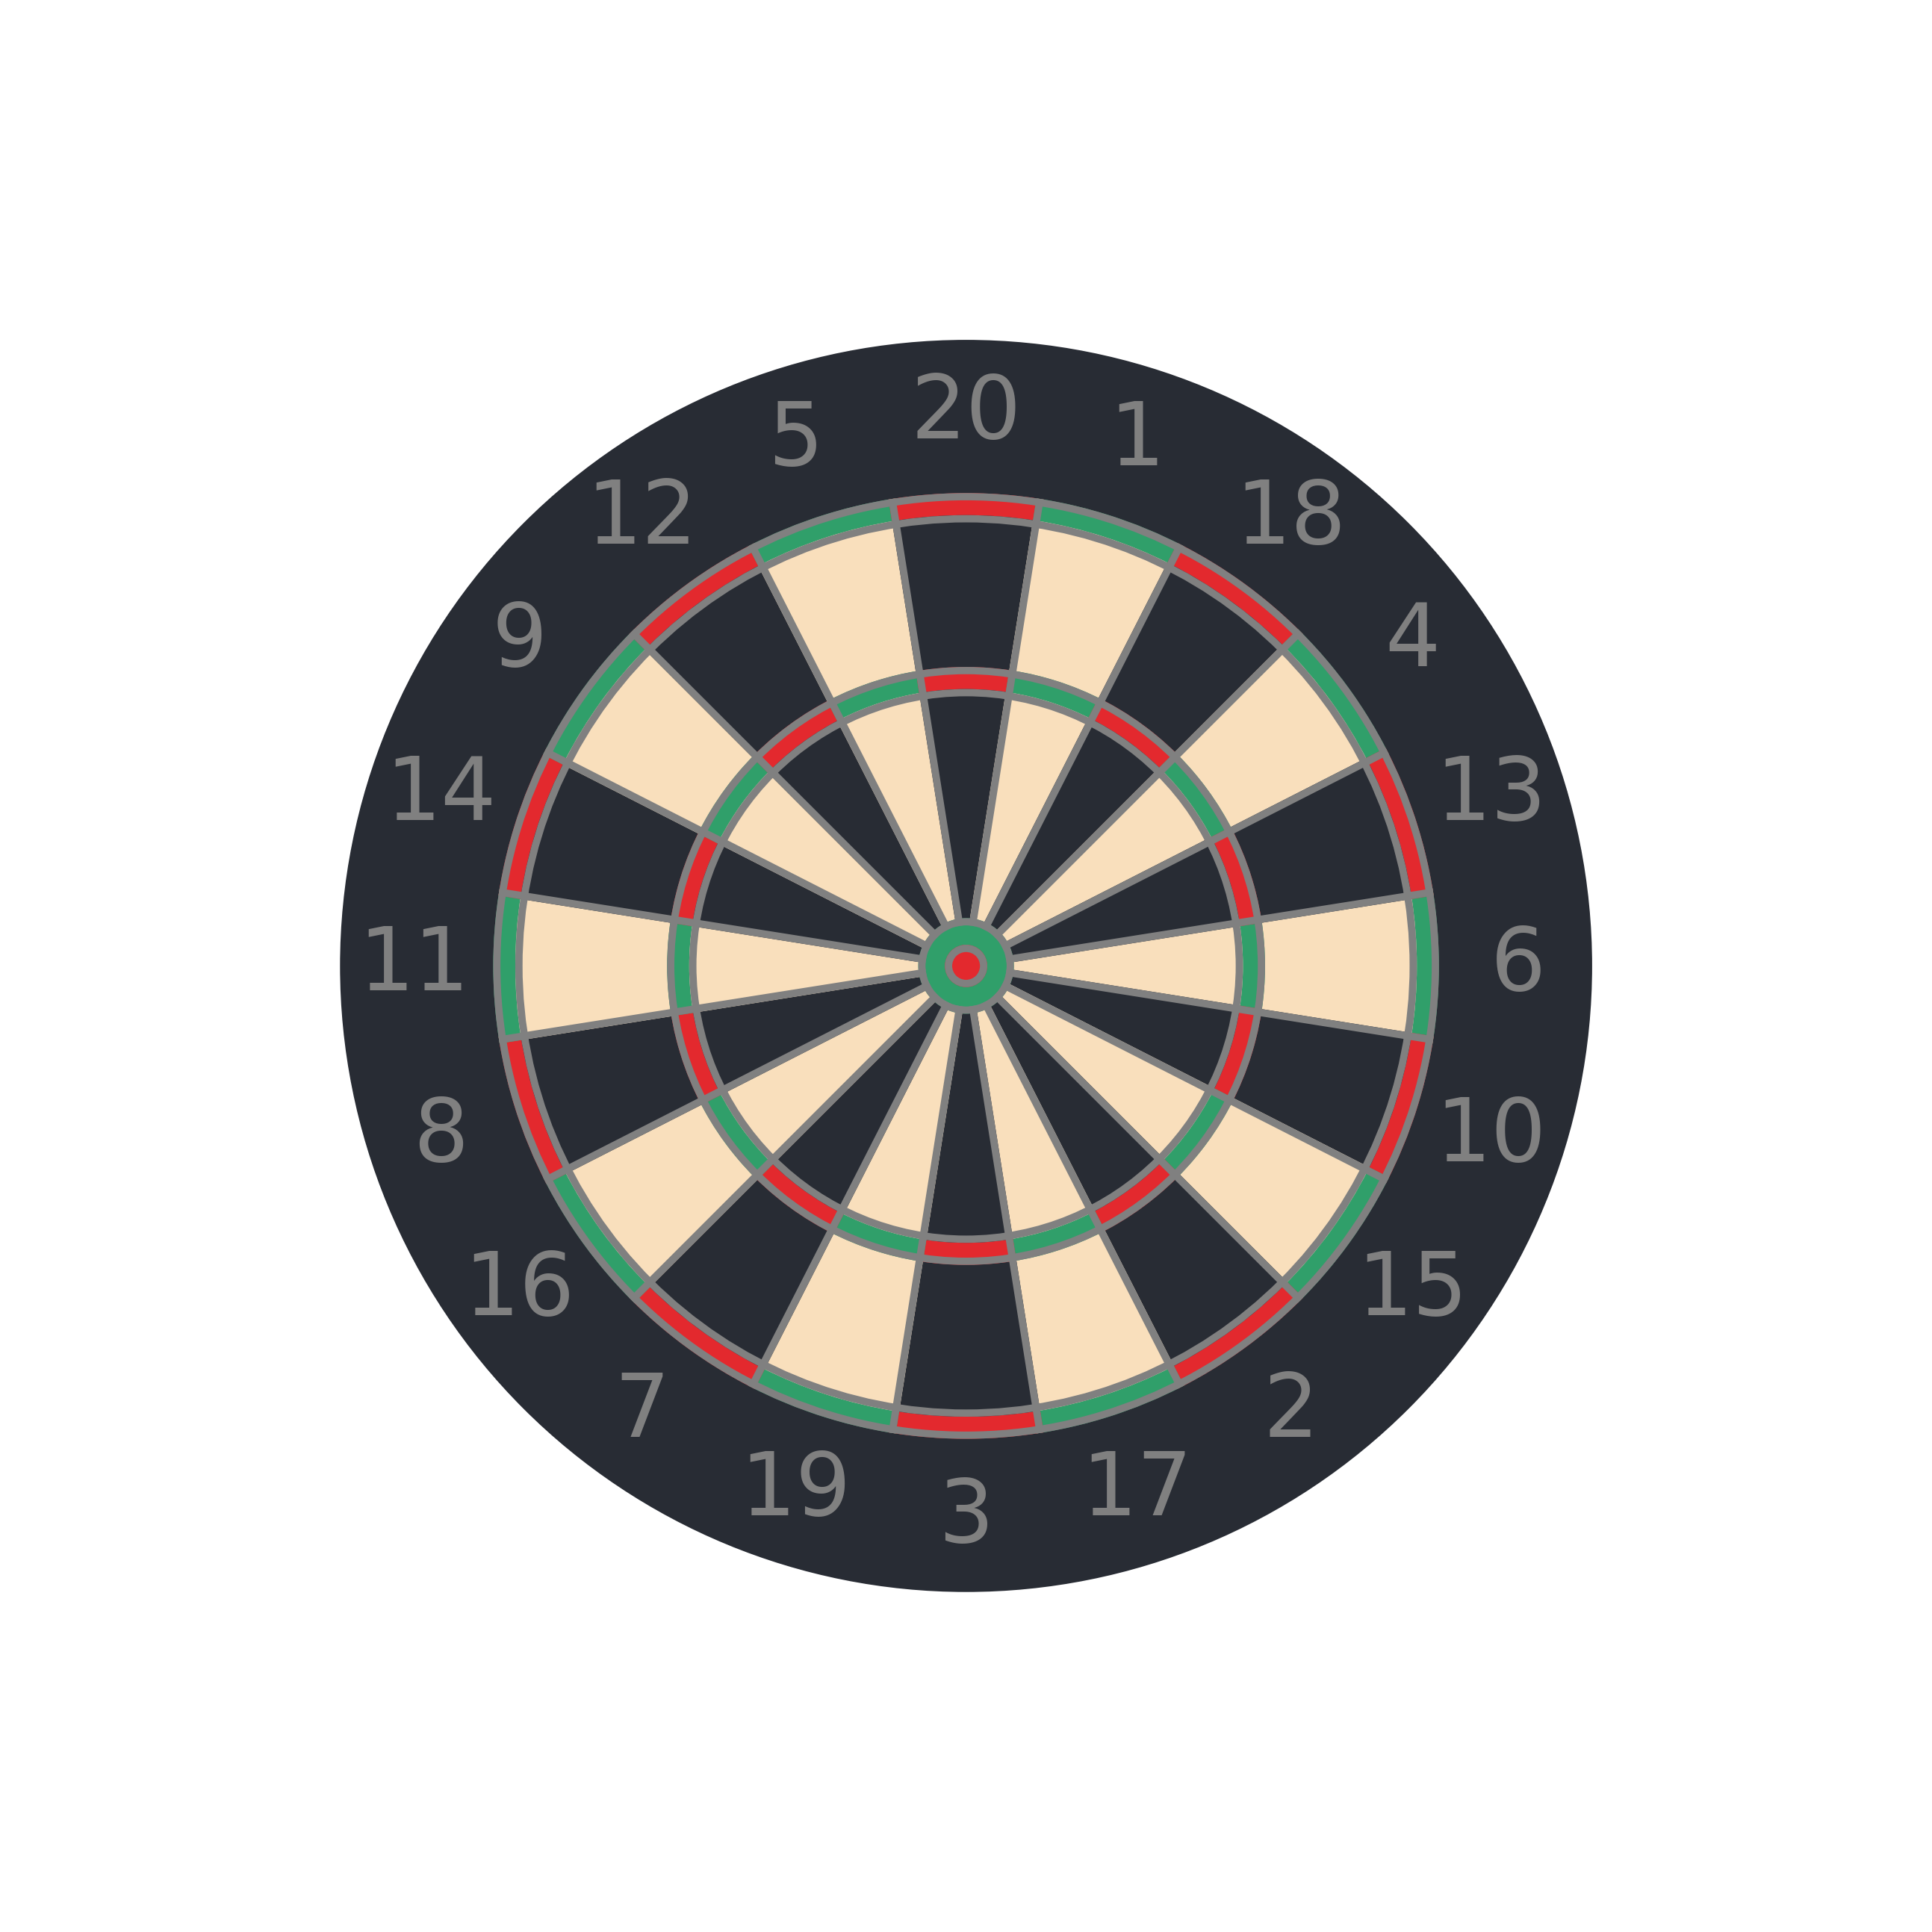
Positioning
We wish to map a point in image coordinates to a position on the board.

Slide 10
Positioning
Using the detection algorithm previously discussed, we can detect the coordinate of the dart tip within the image.

Slide 11
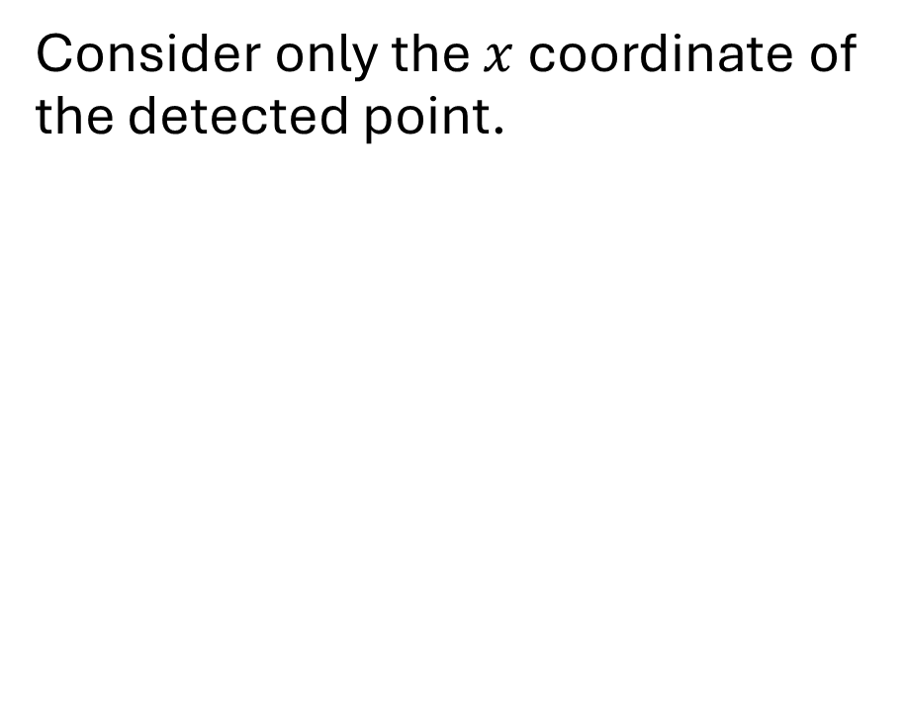
Positioning
Consider only the $x$ coordinate of the detected point.

Slide 12
Positioning
As we are only considering the x coordinate from the image, we can simplify the diagram to be in 2 dimensions
Angle can be calculated by …

Slide 13
Positioning
In 2D this is what the diagram looks like

Slide 14
Positioning
The dart, therefore, lies along this line.

Slide 15
Positioning
We may have to perform transformations to account for varying camera positions.
Use the known position of the cameras.
Setup such that the centre line goes through the middle of the board.

Slide 16
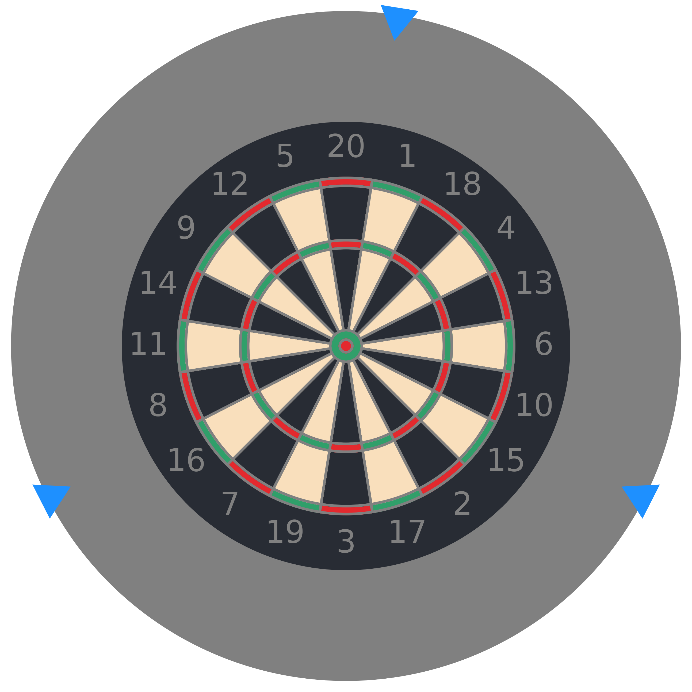
Positioning
Using two cameras, we can calculate the position of the dart on the board.
3 cameras prevent darts obstructing the view of other darts

Slide 17
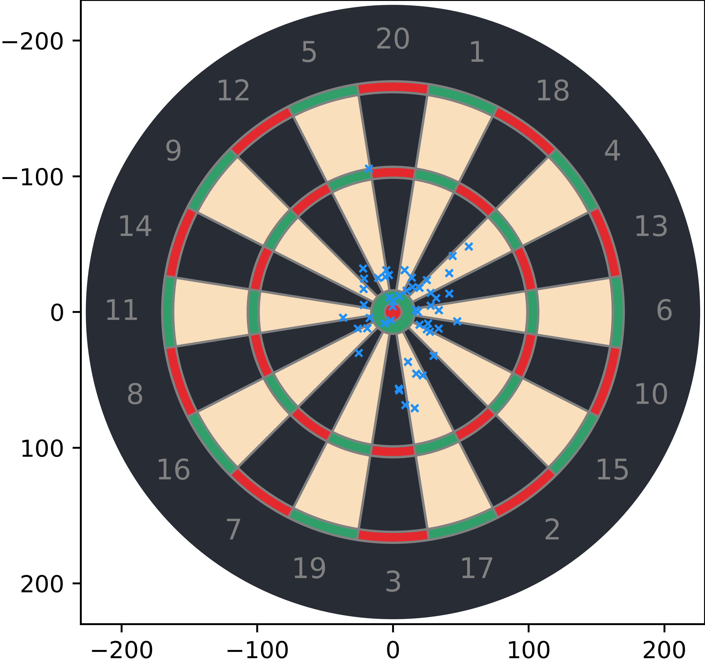
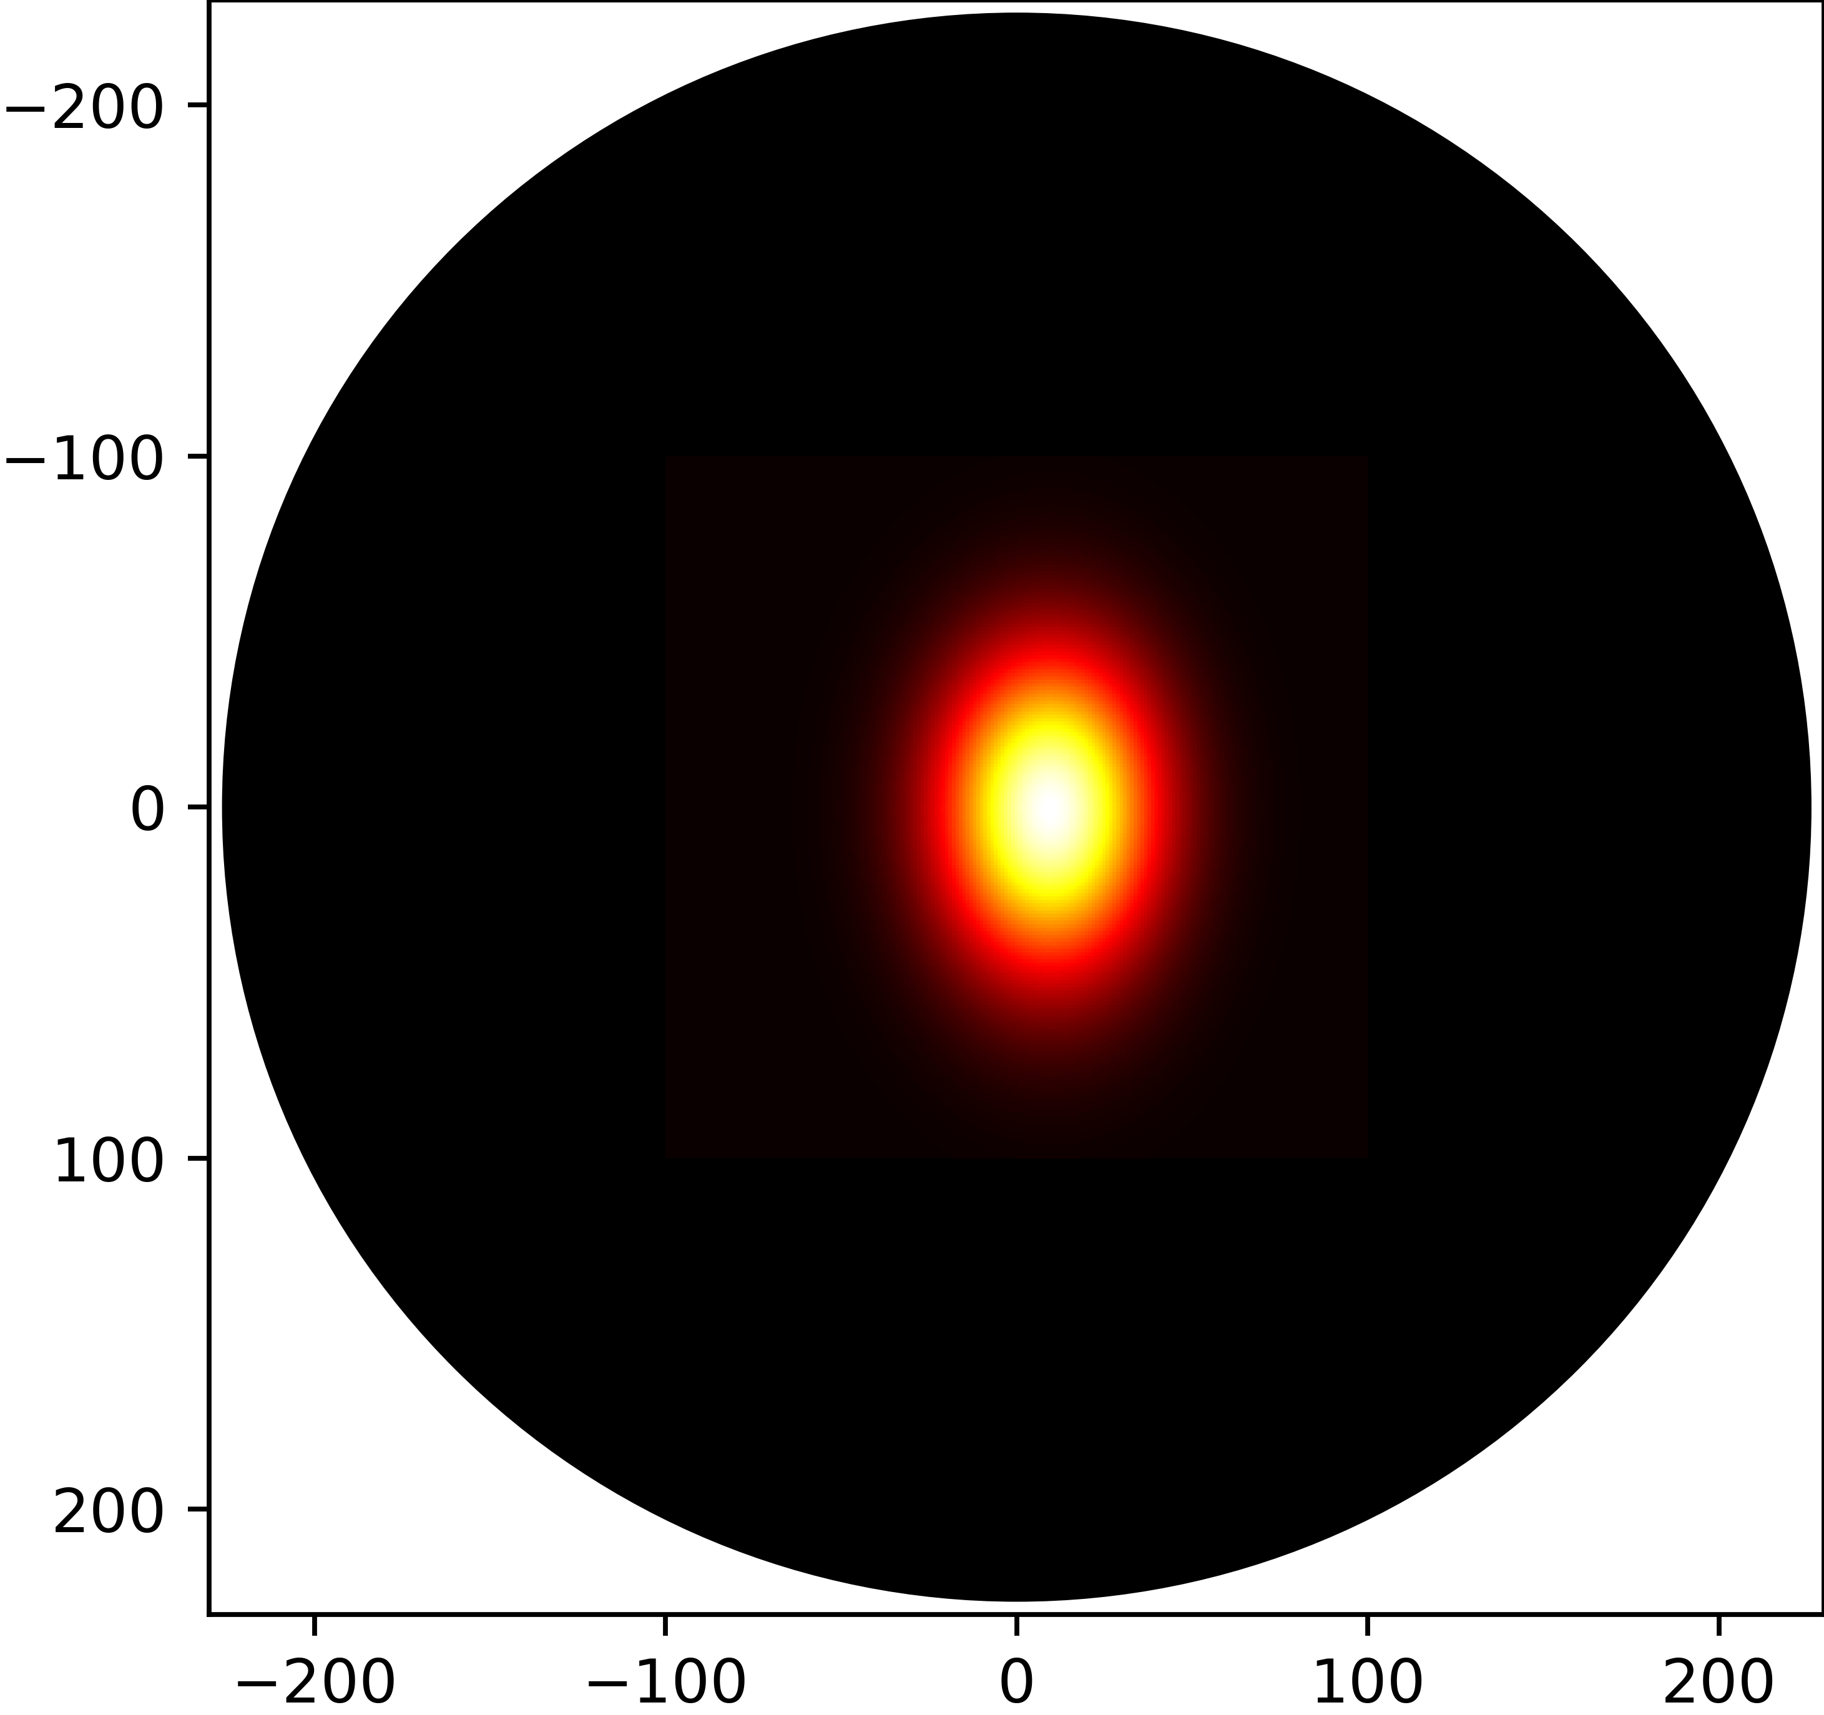
Calculating a Player’s Skill
Throw N darts aiming for the centre of the board.
Take their x and y coordinates.
Assume independence between horizontal and vertical distribution.
Calculate the distribution of these points.

Slide 18
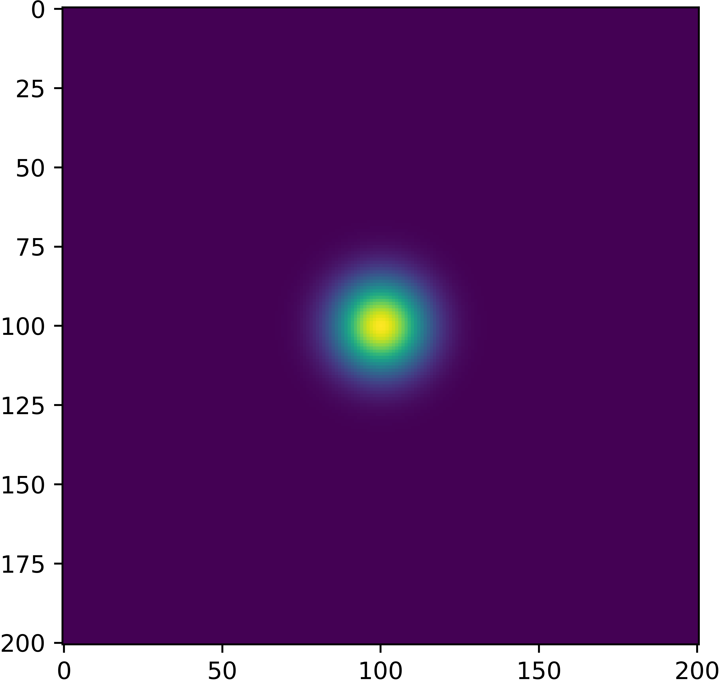
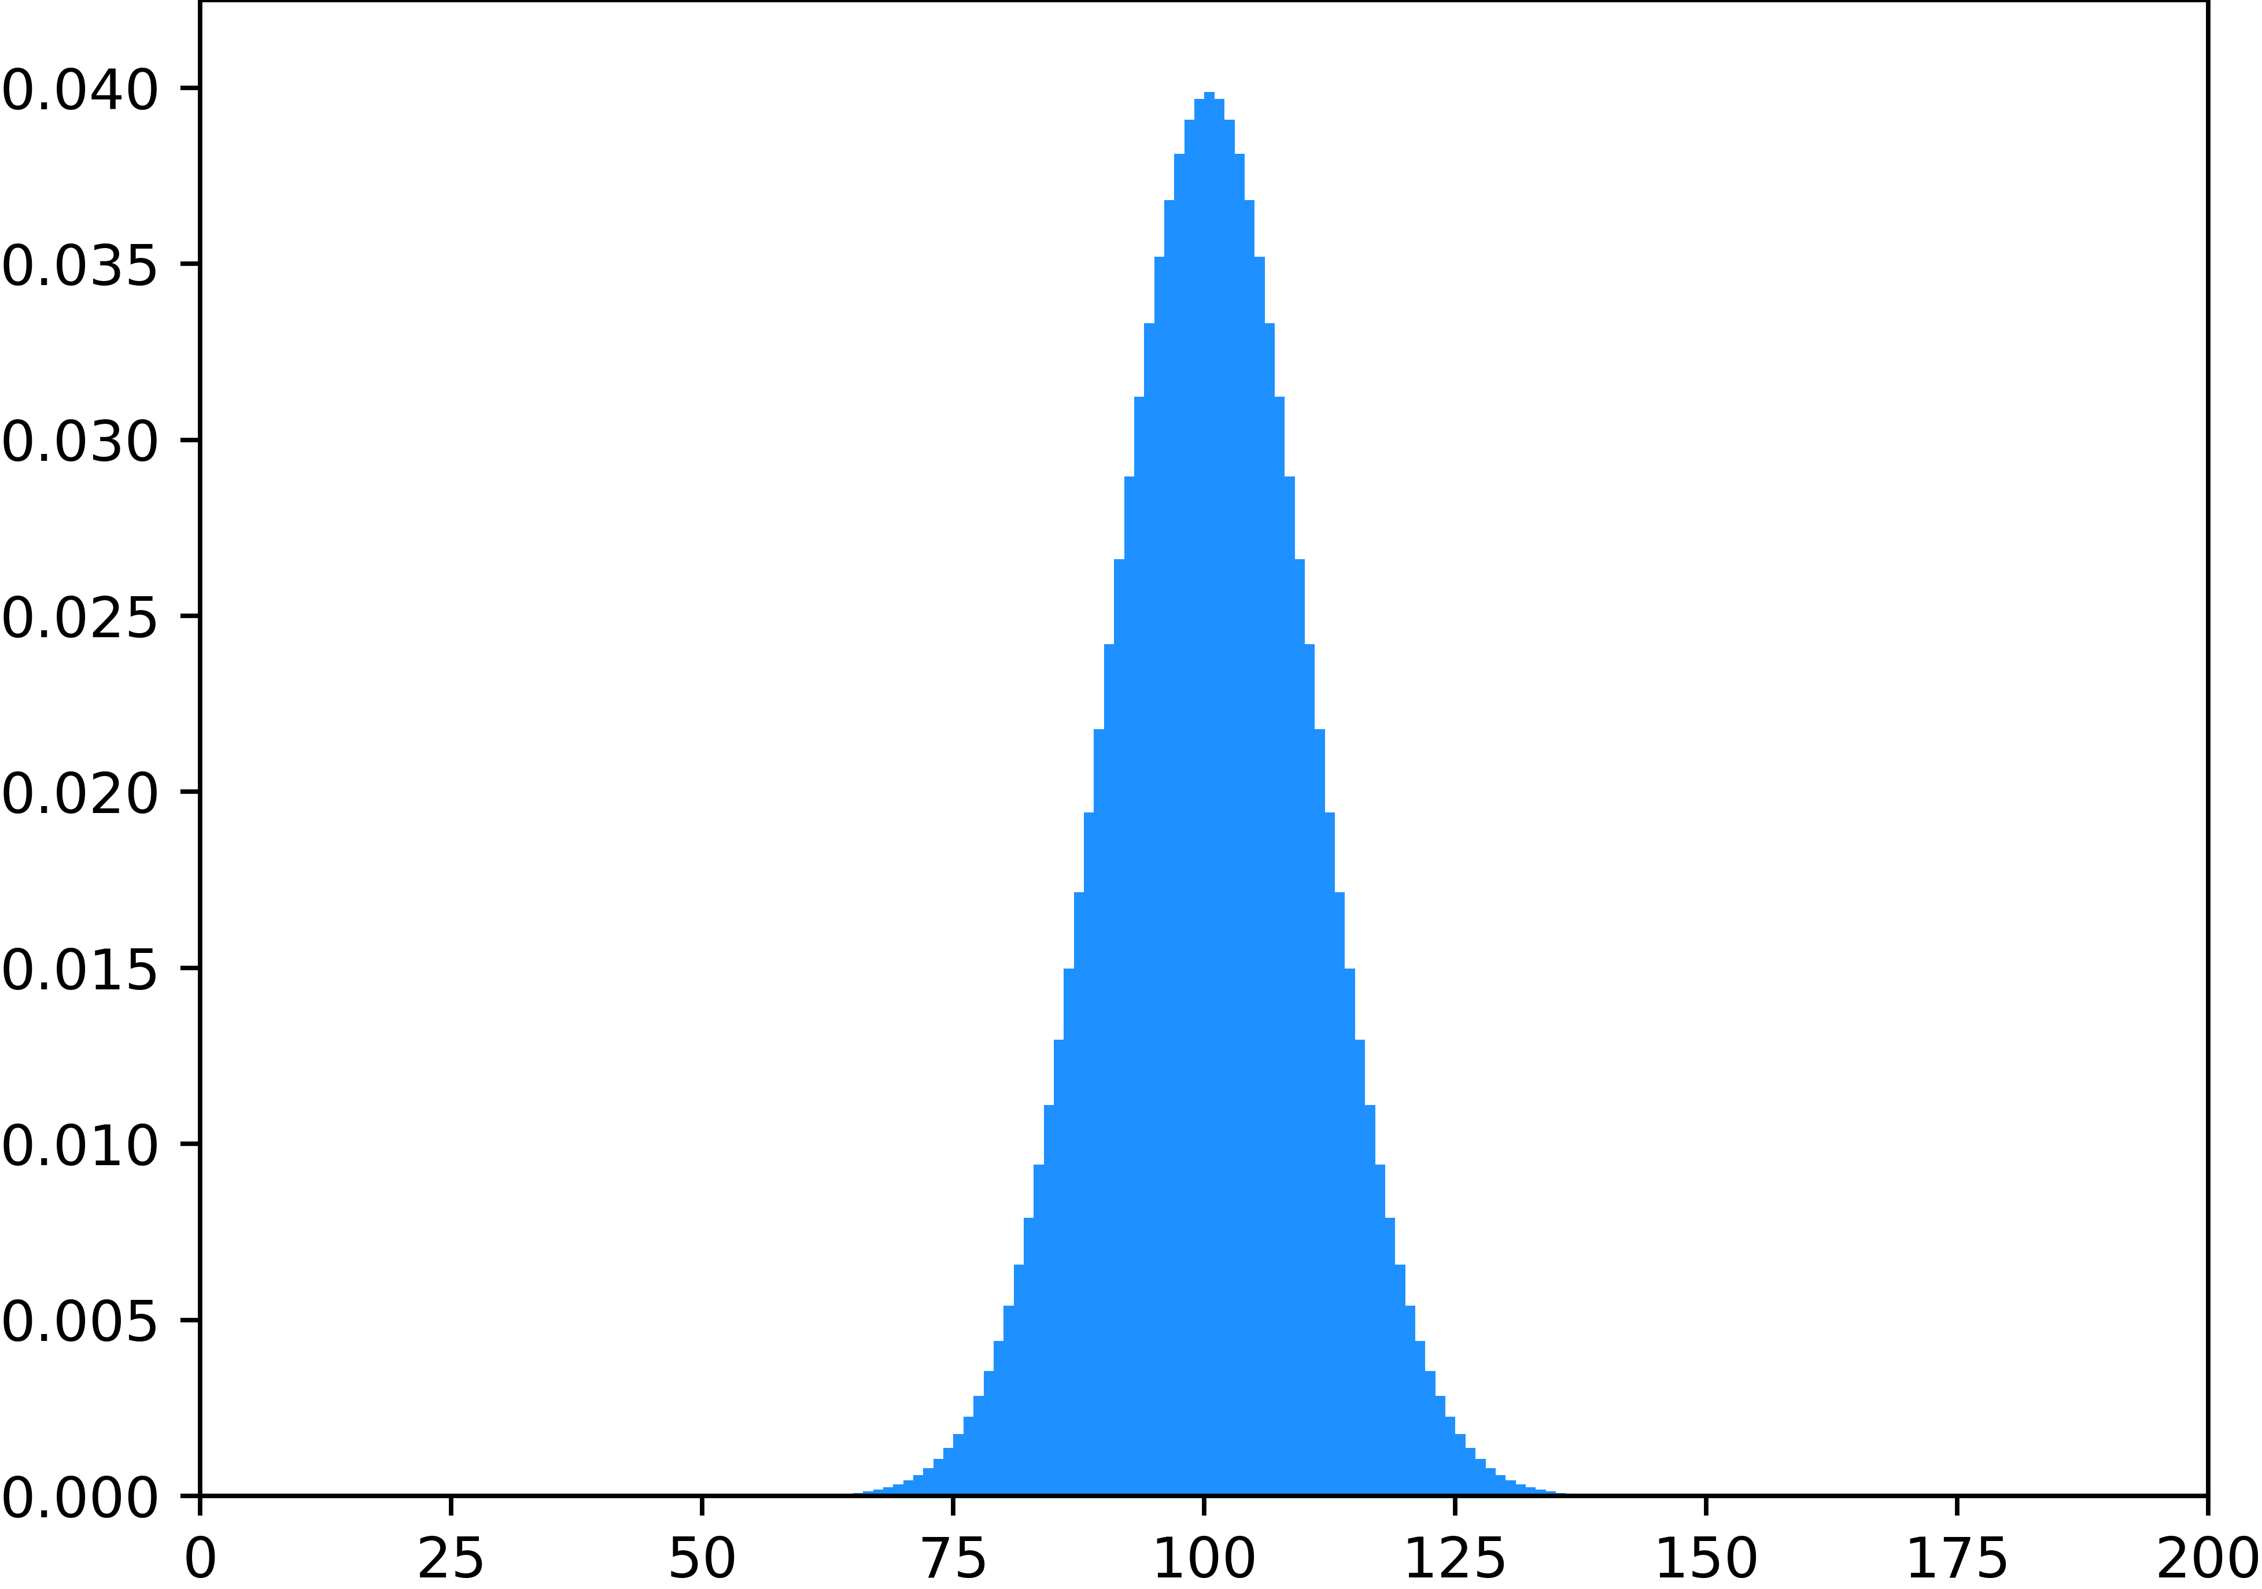
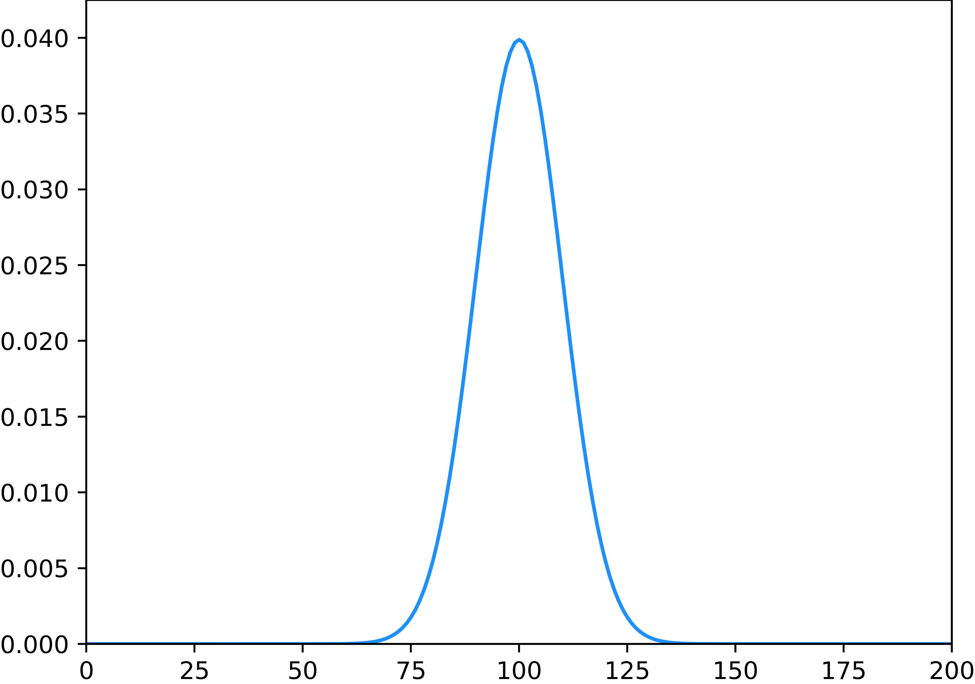
Standard deviation
Consider either the horizontal or vertical deviation of throws.
Use the CDF to calculate the probability within 1mm intervals
We can create a skill heatmap by taking the outer product of the two distributions

Slide 19
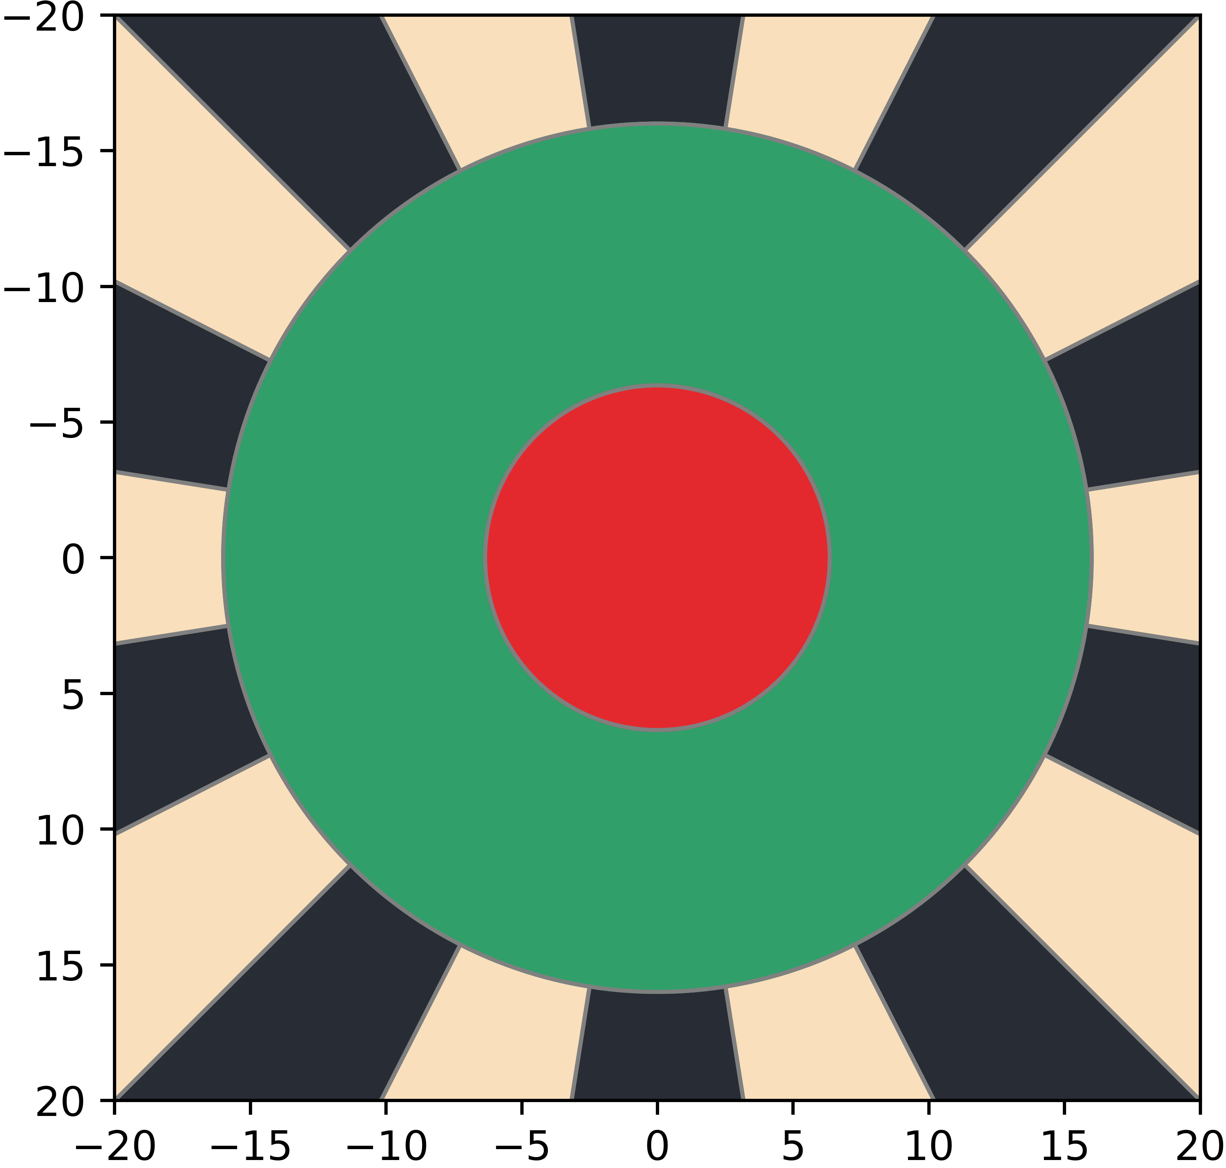

Discretisation
Divide the board into a grid on a mm scale

Slide 20
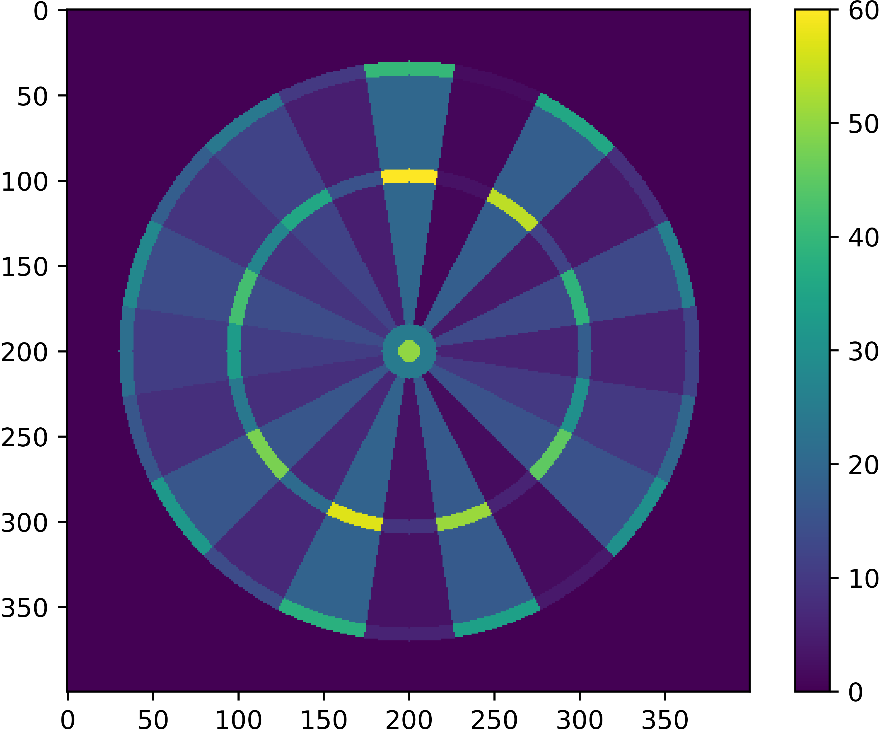
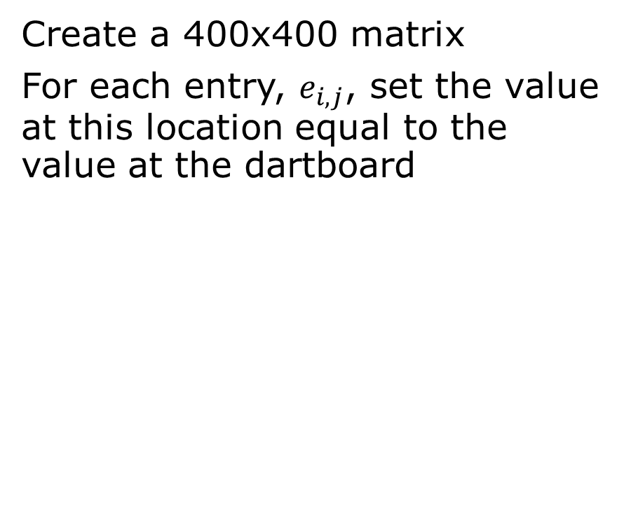
Score Matrix
Create a 400x400 matrix
For each entry, $e_{i,j}$, set the value at this location equal to the value at the dartboard

Slide 21
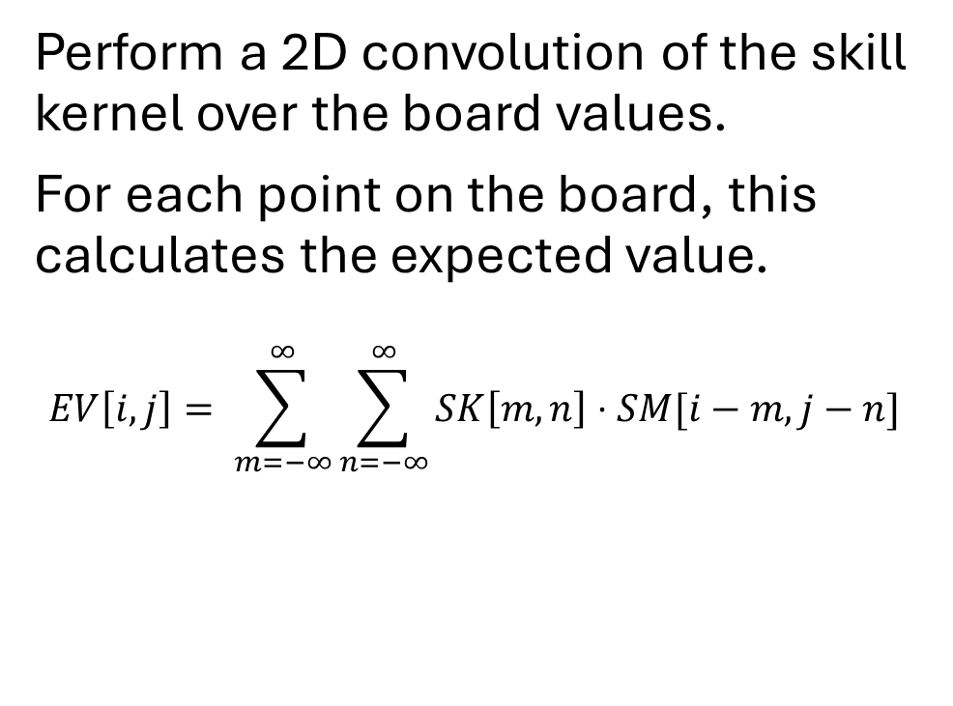
Calculating Expected Value
Perform a 2D convolution of the skill kernel over the board values.
For each point on the board, this calculates the expected value.
$$EV\left[i,j\right]= \sum_{m=−∞}^{∞}{\sum_{n=−∞}^{∞}{SK\left[m,n\right]⋅SM[i−m,j−n]}}$$
Score Matrix
0
5
20
1
18
0
4
0
0
0
4
13
7
0
0
0
0
6
Skill Kernel
0
0
0
0
0
10
2
3
0
0
0
0
0
15
0
0
0
1
Expected Value
0
0
19
3
2
0
6
0
0
56

Slide 22
Calculating Expected Value (Faster)
As we assumed that throw variance is independent in the horizontal and vertical directions, we can perform two 1D convolutions rather than one 2D convolution
Score Matrix
0
Score Matrix
0
5
20
1
18
0
0
5
5
20
20
1
1
18
18
0
0
4
0
0
0
4
13
4
4
0
0
0
0
0
0
4
4
13
13
Skill Kernel
7
0
0
0
0
6
Skill Kernel
7
7
0
0
0
0
0
0
0
0
6
6
0
0
0
0
0
10
2
3
0
0
0
0
0
0
0
0
0
0
0
10
10
2
2
0
0
0
0
15
0
0
0
0
0
0
0
0
0
0
0
15
15
0
0
Expected Value
Expected Value
0
0
19
3
2
0
0
0
0
0
19
19
3
3
2
2
0
0
6
6
56
56
56

Slide 23
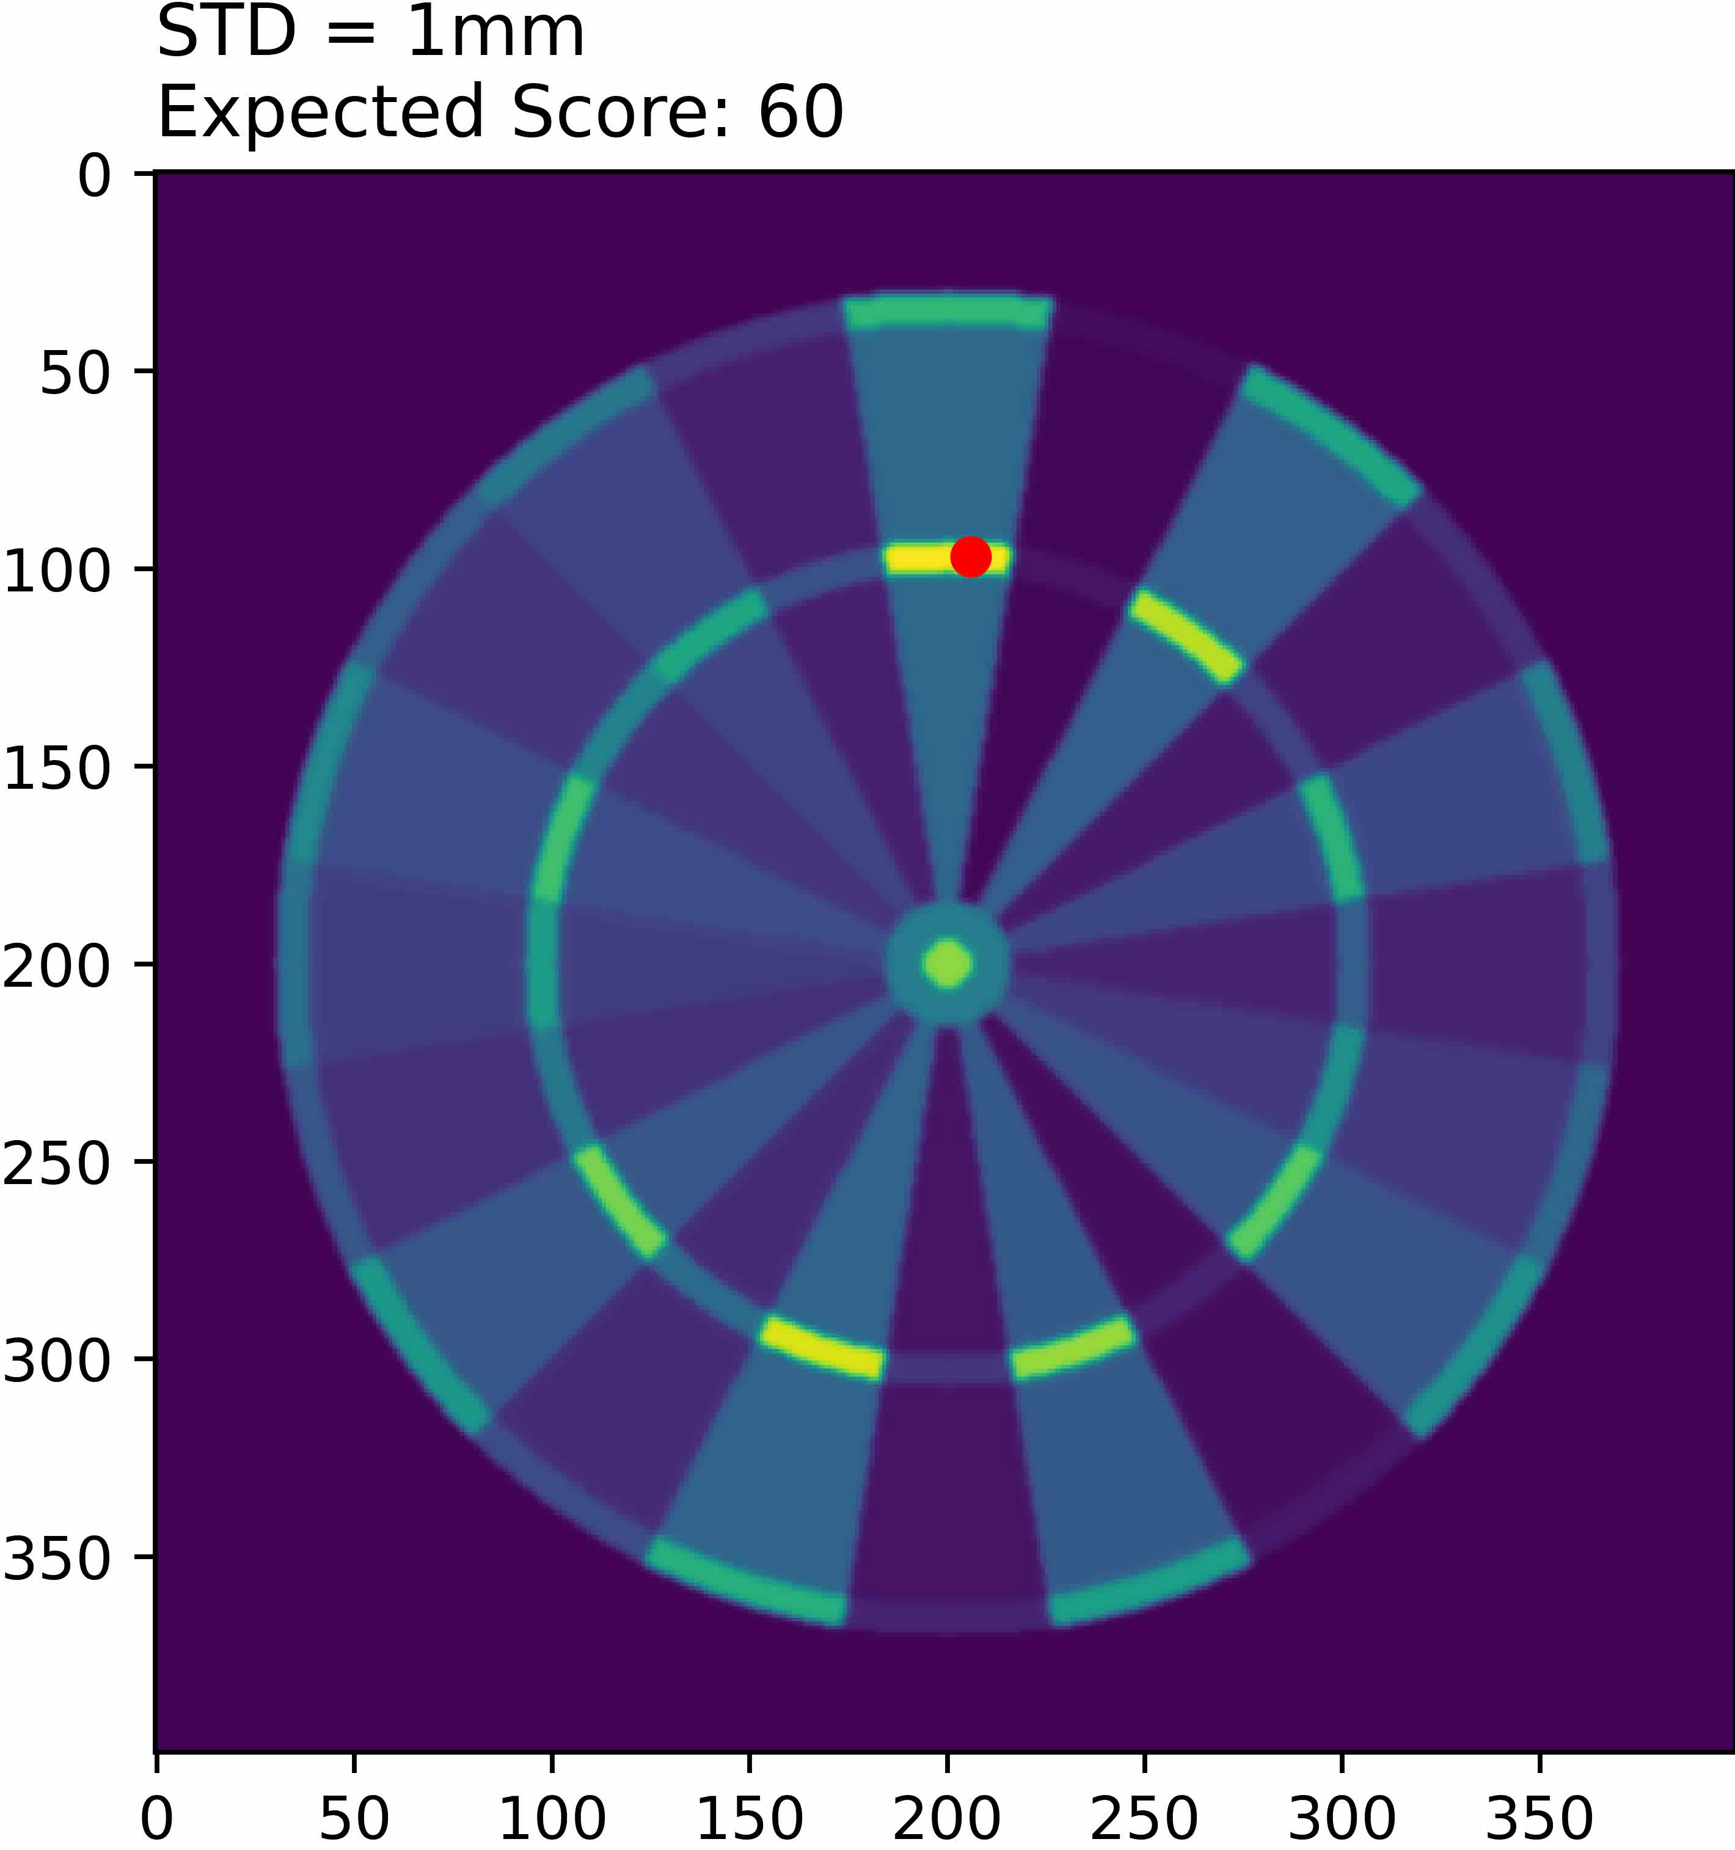
Expected Value
Circular normal distribution with standard deviation ranging from 1mm to 101mm.
Location that maximises expected score.

Slide 24
Probability of X
More interesting when checking out

Slide 25
Evaluation
Correctly identify individual darts.
Dataset
Multiple darts? Closely grouped?

Slide 26
Demo

Slide 27
Questions

